Slide 1
Introduction to UML mainly based on Bernd Bruegge’s book and UML Reference manual. Also contains some personal points of view/opinions and examples using OCLE
Dan CHIOREAN
Babeş-Bolyai University
chiorean@cs.ubbcluj.ro

Slide 2
Introduction to UML
What is modeling?
Modeling consists of building an abstraction of reality
Model – an abstract description of a problem/problem solution
Abstractions are simplifications because:
They ignore irrelevant details and
They only represent the relevant details
What is relevant or irrelevant depends on the purpose of the model
We use modeling to produce software because:
Software is getting increasingly more complex
Modeling is a means for dealing with complexity

Slide 3
Introduction to UML
Abstraction as key technique in modeling
Two definitions for abstraction:
• Abstraction is a thought process where ideas are distanced from objects
• Abstraction as activity
• Abstraction is the resulting idea of a thought process where an idea has been distanced from an object
• Abstraction as entity
• Ideas can be expressed by models
Abstraction allows us to ignore unessential details

Slide 4
Introduction to UML
Modeling challenges

Slide 5
Introduction to UML
Models must be falsifiable
• Testing: The act of disproving a model.

Slide 6
Introduction to UML
Models must be falsifiable
• Karl Popper (“Objective Knowledge):
• There is no absolute truth when trying to understand reality. One can only build theories, that are “true” until somebody finds a counter example
• Falsification: The act of disproving a theory or hypothesis
• The truth of a theory is never certain. We must use phrases like:
• “by our best judgement”, “using state-of-the-art knowledge”
• In software engineering any model is a theory:
• We build models and try to find counter examples by:
• Requirements validation, user interface testing, review of the design, source code testing, system testing, etc.
•

Slide 7
Introduction to UML
Three ways to deal with complexity
Abstraction and Modeling
Decomposition
Hierarchy
UML supports all these three ways/techniques

Slide 8
Introduction to UML
Decomposition
Complex systems are hard to understand
The 7 +- 2 phenomena
Our short-term memory cannot store more than 7+-2 pieces at the same time -> limitation of the brain
TUM Phone Number: 498928918204
Chunking:
Group collection of objects to reduce complexity
State-code, city-code, TUM-code, Office-Part

Slide 9
Introduction to UML
Object-oriented decomposition - What is this?
Object-oriented decomposition is good. Unfortunately, depending on the purpose of the system, different objects can be found

Slide 10
Introduction to UML
Object-oriented decomposition - What is this?

Slide 11
Introduction to UML
Object-oriented decomposition - What is this?
Depending on the purpose of the system, different objects might be found
Identify the purpose of a system is crucial

Slide 12
Introduction to UML
Hierarchy
Another way to deal with complexity is to provide relationships between these chunks
One of the most important relationships is hierarchy. There are 2 useful/special hierarchies:
"Part-of" hierarchy
"Is-kind-of" hierarchy

Slide 13
Introduction to UML
Part of Hierarchy - Aggregation

Slide 14
Introduction to UML
Is Kind of Hierarchy - Taxonomy

Slide 15
Introduction to UML
What is UML?
• UML (Unified Modeling Language) - 1997
• Nonproprietary standard for modeling software systems, OMG
• Convergence of notations used in object-oriented methods:
• OMT (James Rumbaugh and colleagues)
• Booch (Grady Booch)
• OOSE (Ivar Jacobson)
• Information at the OMG portal http://www.uml.org/
• Commercial tools: Rational Software Modeler (IBM), Rational Rhapsody, Enterprise Architect, Visual Paradigm, MagicDraw

Slide 16
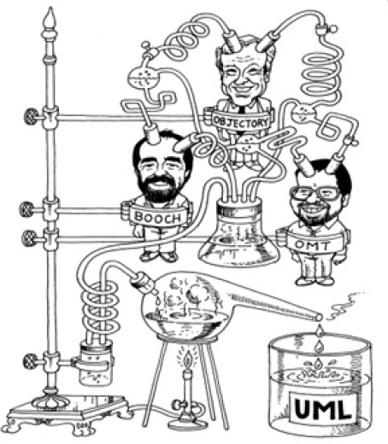
Introduction to UML
History of UML
the first version of UML- November 1997
The version 1.5 implemented in OCLE was adopted in March 2003, formal-03-03-01.pdf, 736 pag. – including OCL 47 pag. chap. 6
The current Version 2.5.1 - formal-17-12-05.pdf, 796 pag. – OCL specified in another doc. 262 pag. - formal-14-02-03.pdf, OCL 2.4, that is aligned with UML 2.4.1

Slide 17
Introduction to UML
Important to know
You can solve 80% of the modeling problems by using 20 % UML
We teach you those 20%
80-20 rule: Pareto principle
Vilfredo Pareto, 1848-1923
Introduced the concept of Pareto Efficiency,
Founder of the field of microeconomics.

Slide 18
Introduction to UML
Most important features of UML
Apart from "languages“ of OMT, OOD/Booch, OOSE methods contributing at UML definition, UML is specified in a more rigorous manner by means of concrete syntax, abstract syntax and semantics
The abstract syntax is described by means of the UML metamodel and WFRs (invariants on metamodel classes). The language describing the UML metamodel, MOF is a subset of the UML language
Beginning with the first version, UML included the OCL

Slide 19
Introduction to UML
What is a Model, View, Diagram?
UML is a language supporting model specification
A model is an abstraction describing a problem/problem domain, a problem solution/ system or a subsystem:
• a system that no longer exists,
• an existing system,
• a future system to be built.
A view depicts selected aspects of a model
A diagram/notation is a set of graphical/textual rules for depicting views and formal specifications

Slide 20
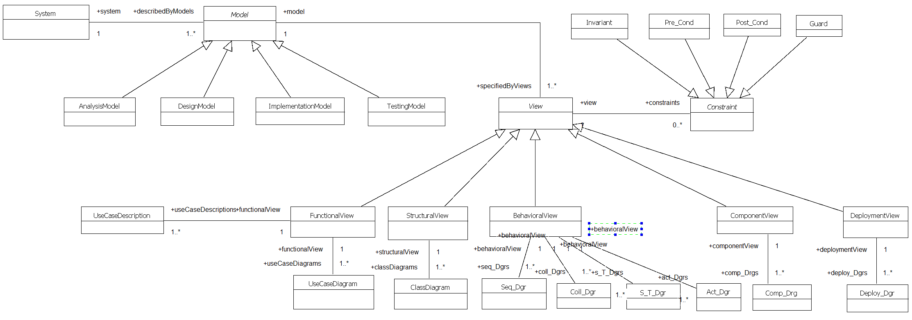
Introduction to UML
UML Models, Views, Diagrams

Slide 21
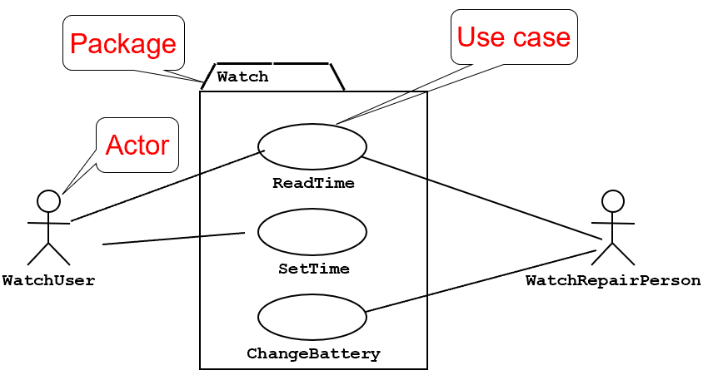
Introduction to UML
UML – A better understanding of the problem – the functionality
Use case diagrams represent the functionality of the system from user’s point of view

Slide 22
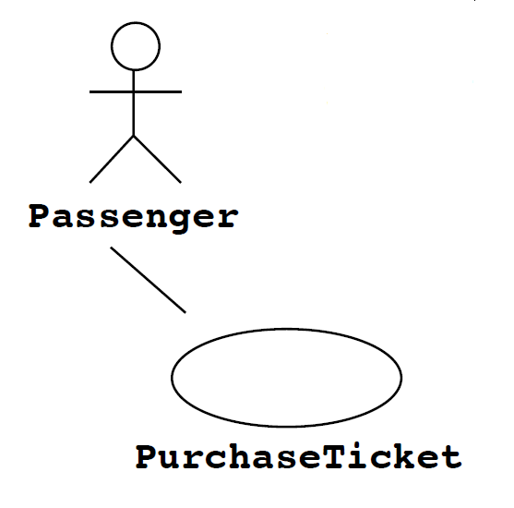
Introduction to UML
UML – the functional view
UCDs are used during requirements elicitation and analysis to represent external behavior (“visible from the outside of
the system”)
A use case represents a functionality provided by the system
An Actor represents a role, that is, a type of user of the system
The set of all use cases that completely describe the functionality of the system form the Use Case View/Model

Slide 23
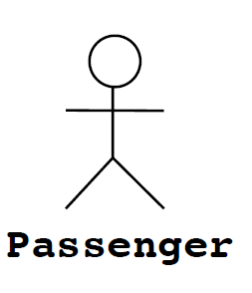
Introduction to UML
UML – the functional view - Actors
An actor is a model of an external entity which interacts (communicates) with the system:
User
External system (Another system)
Physical environment (e.g. Weather)
• An actor has a unique name and an optional description
Examples:
Passenger: A person in the train
GPS satellite: An external system that provides the system with GPS

Slide 24
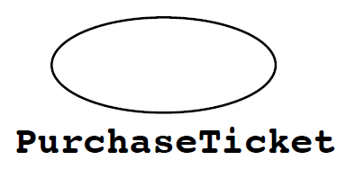
Introduction to UML
UML – the functional view – Use Case
A Use Case represents a class of functionality provided by the system
Use Cases can be described textually, with a focus on the event flow between actor and system
The textual Use Case description consists of 6 parts:
Unique name
Participating actors
Entry conditions
Exit conditions
Flow of events
Special requirements.

Slide 25
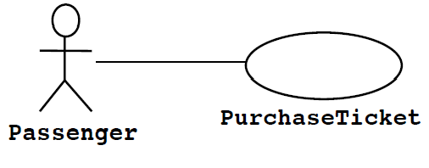
Introduction to UML
UML – the functional view – Use Case
5. Flow of events:
Passenger selects the number of zones to be traveled
2. Ticket Distributor displays the amount due
3. Passenger inserts money, at least the amount due
4. Ticket Distributor returns change
5. Ticket Distributor issues
Ticket
6. Special requirements: None.
Name: Purchase ticket
2. Participating actor: Passenger
3. Entry condition: Passenger stands in front of Ticket Distributor
Passenger has sufficient money to purchase ticket
4. Exit condition: Passenger has ticket

Slide 26
Introduction to UML
UML –Use Cases relationships
Inheritance Relationship
To express specialization/generalization relations
Extends Relationship
To represent seldom invoked use cases or exceptional functionality
Includes Relationship
To represent functional behavior common to more than one use case.
<<extends>> relationships model exceptional or seldom invoked cases
The exceptional event flows are factored out of the main event flow for clarity
The direction of an <<extends>> relationship is to the extended use case
Use Cases representing exceptional flows can extend more than one use case.

Slide 27
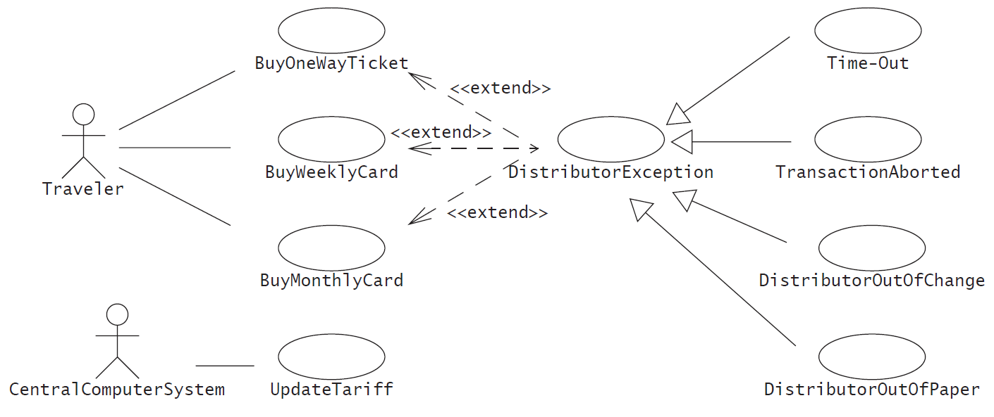
Introduction to UML
UML –Use Cases relationships

Slide 28
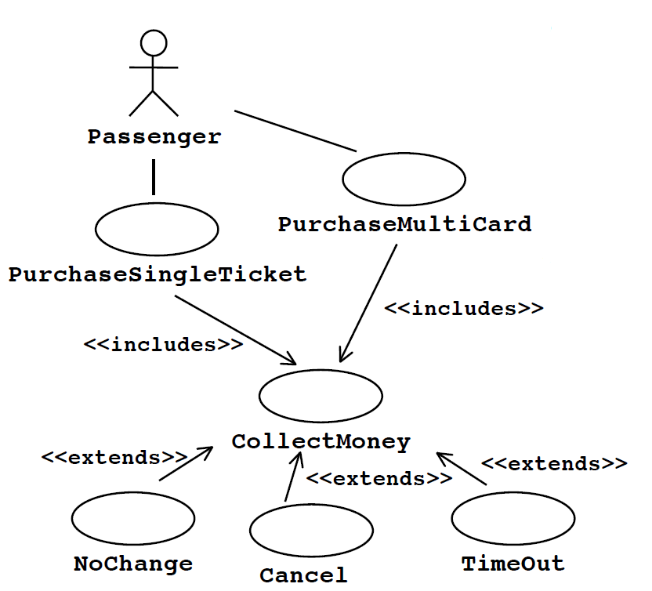
Introduction to UML
UML –Use Cases relationships
<<includes>> relationship represents common functionality needed in more than one use case
<<includes>> behavior is factored out for reuse, not because it is an exception
The direction of an <<includes>> relationship is to the using use case (unlike the direction of the <<extends>> relationship).

Slide 29
Introduction to UML
UML – A better understanding of the problem – the structure
Class diagram represents the structure of the system

Slide 30
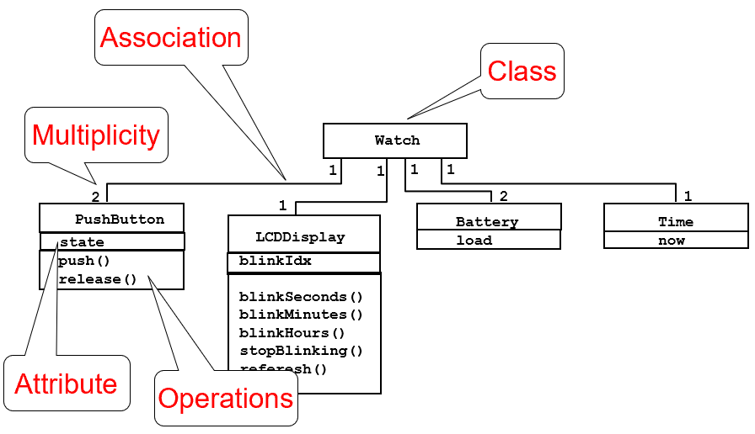
Introduction to UML
UML – A better understanding of the problem – the structure_2
Class diagram represents the structure of the system

Slide 31
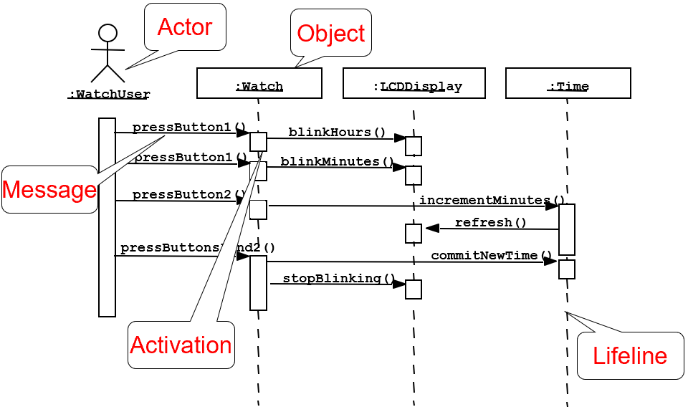
Introduction to UML
UML – A better understanding of the problem – the behavior
Sequence diagrams describe behavior as interactions between objects

Slide 32
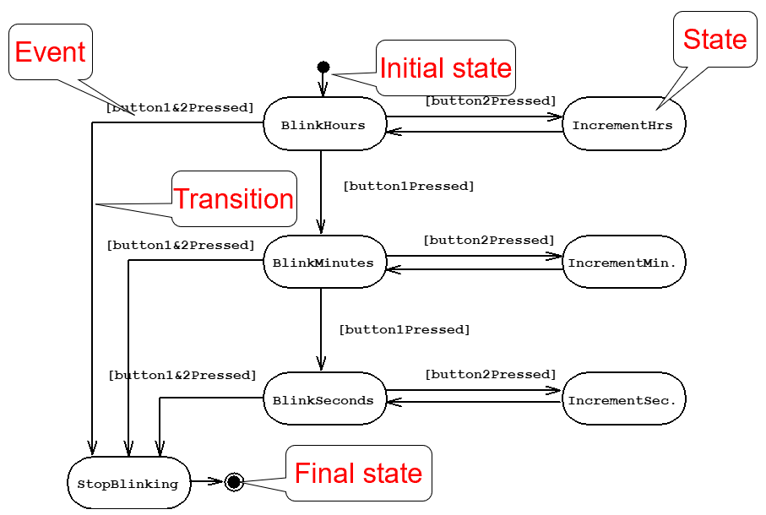
Introduction to UML
UML – A better understanding of the problem – the behavior_2
States transitions diagrams describe behavior by means of states and transitions

Slide 33
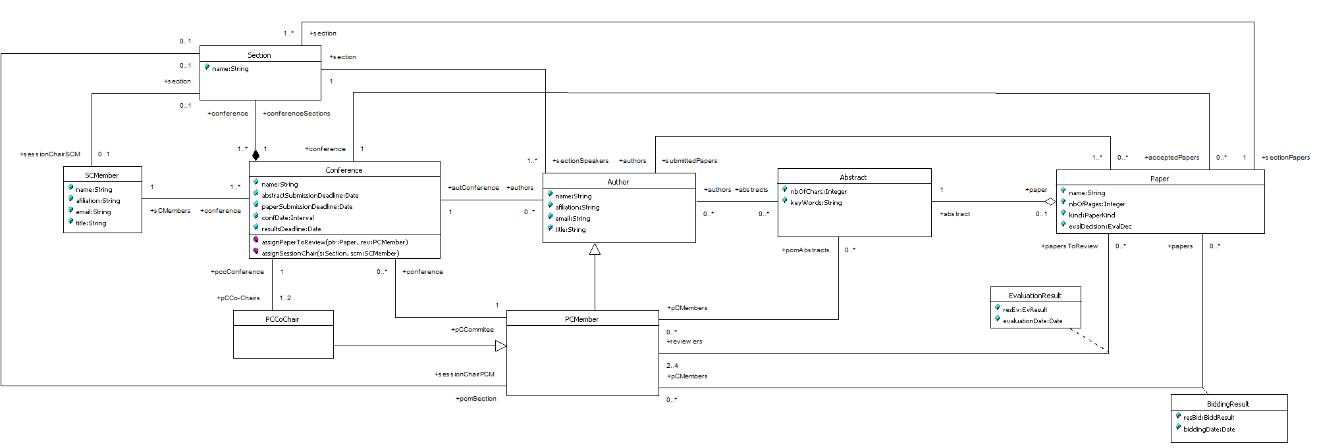
Introduction to UML
UML – Advantages of using Class Diagram
context PCMember
inv approprPapToReview:
self.papersToReview->select(p:Paper | Set{BiddResult::conflict, BiddResult::refuseToEv}->includes(p.biddingResult->any(br| br.pCMembers->includes(self)).resBid))->isEmpty and
self.papersToReview.authors->excludes(self.oclAsType(Author))

Slide 34
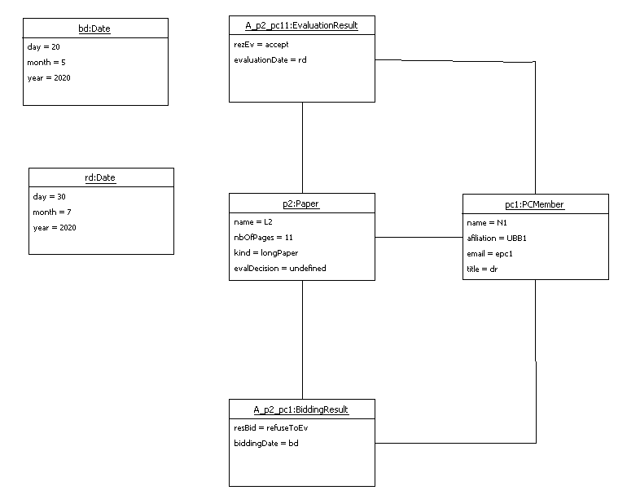
Introduction to UML
UML – Object Diagram Snapshot

Slide 35
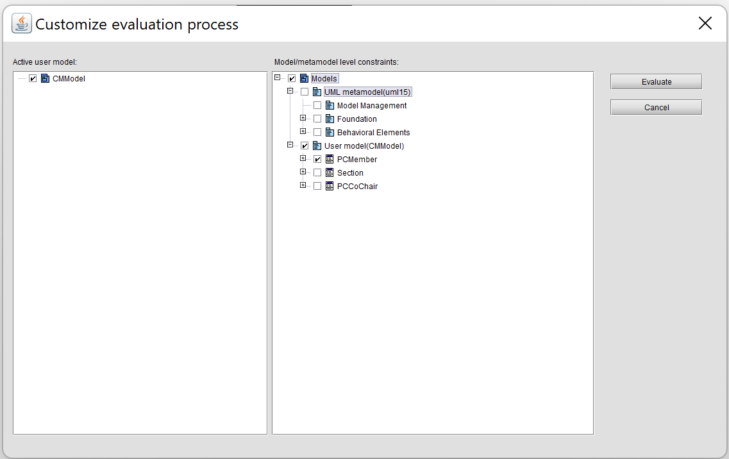
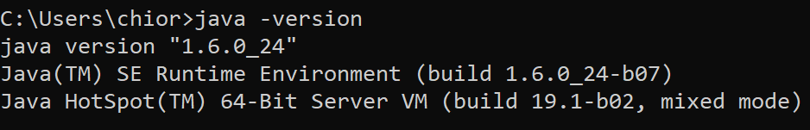
Introduction to UML
UML – OCLE Customize Evaluation

Slide 36
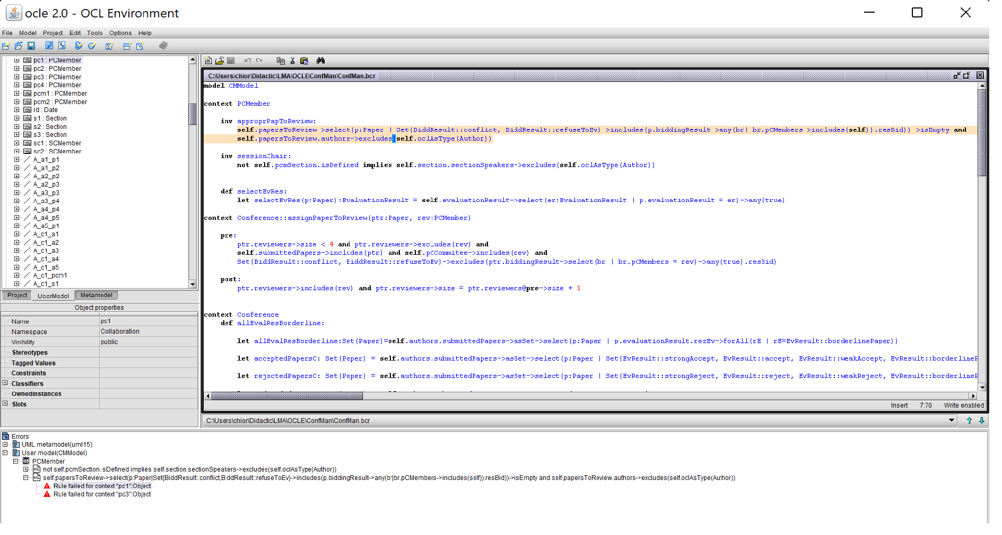
Introduction to UML
UML – Model Checking using OCLE

Slide 37
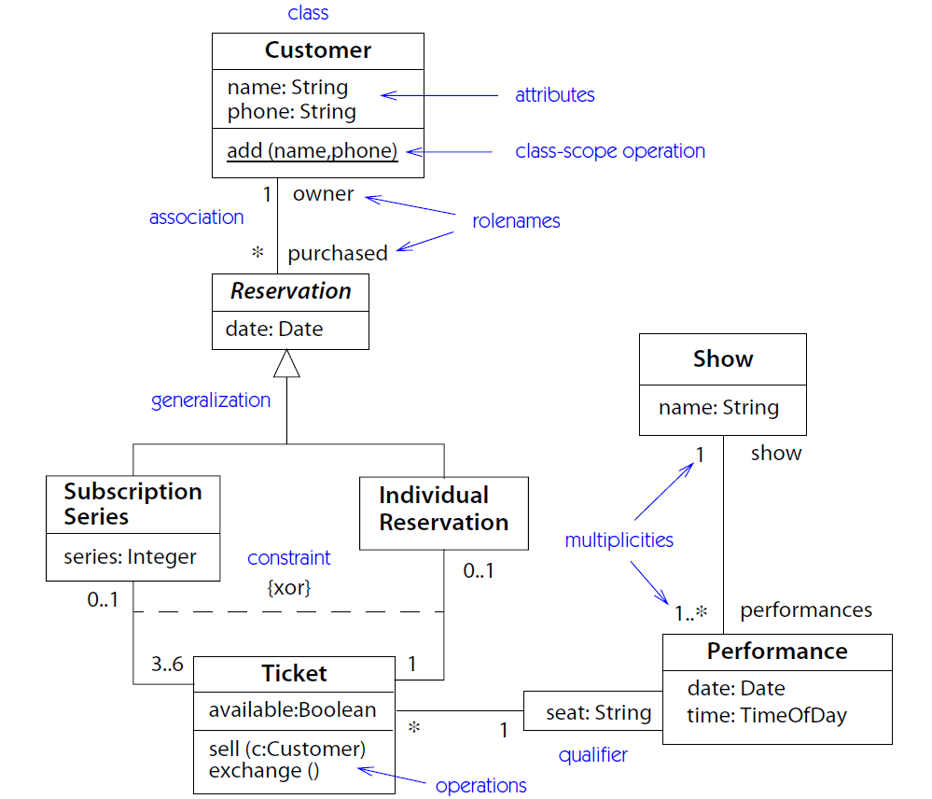
Introduction to UML
UML – CD qualified associations & constraints

Slide 38
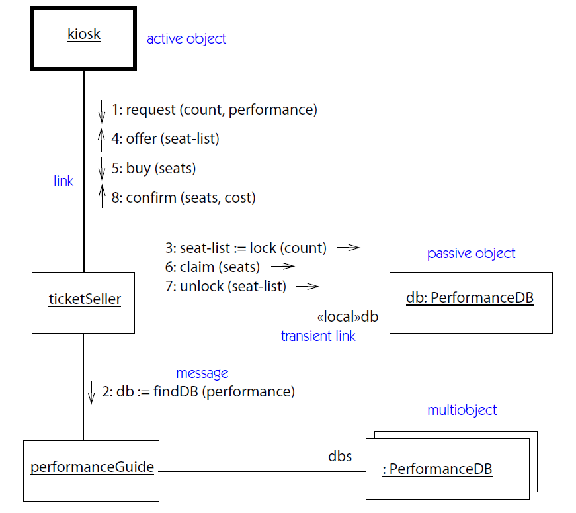
Introduction to UML
UML – Collaboration Diagram

Slide 39
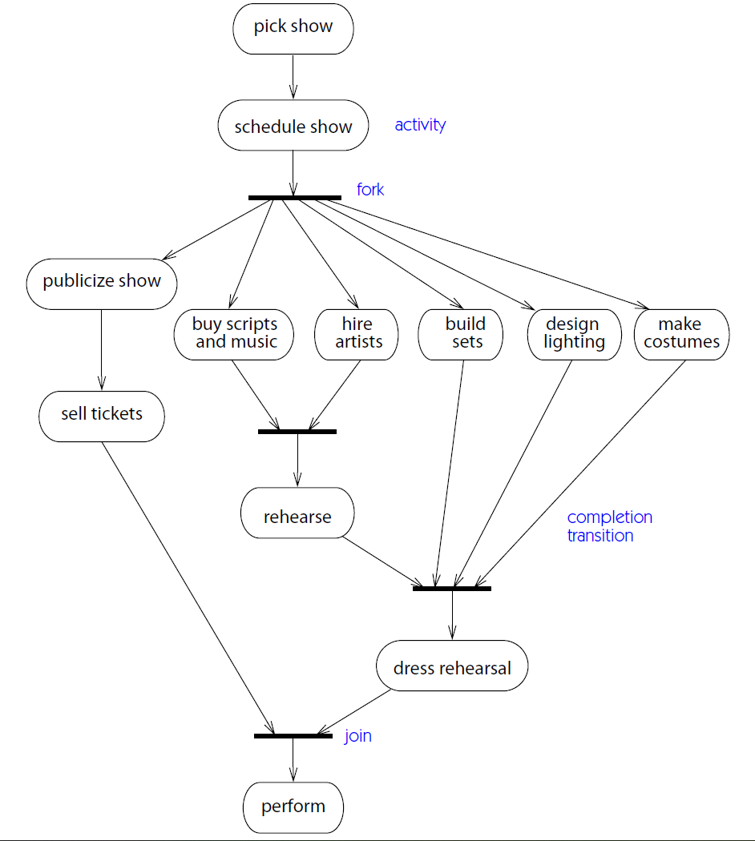
Introduction to UML
UML – Activity Diagram

Slide 40
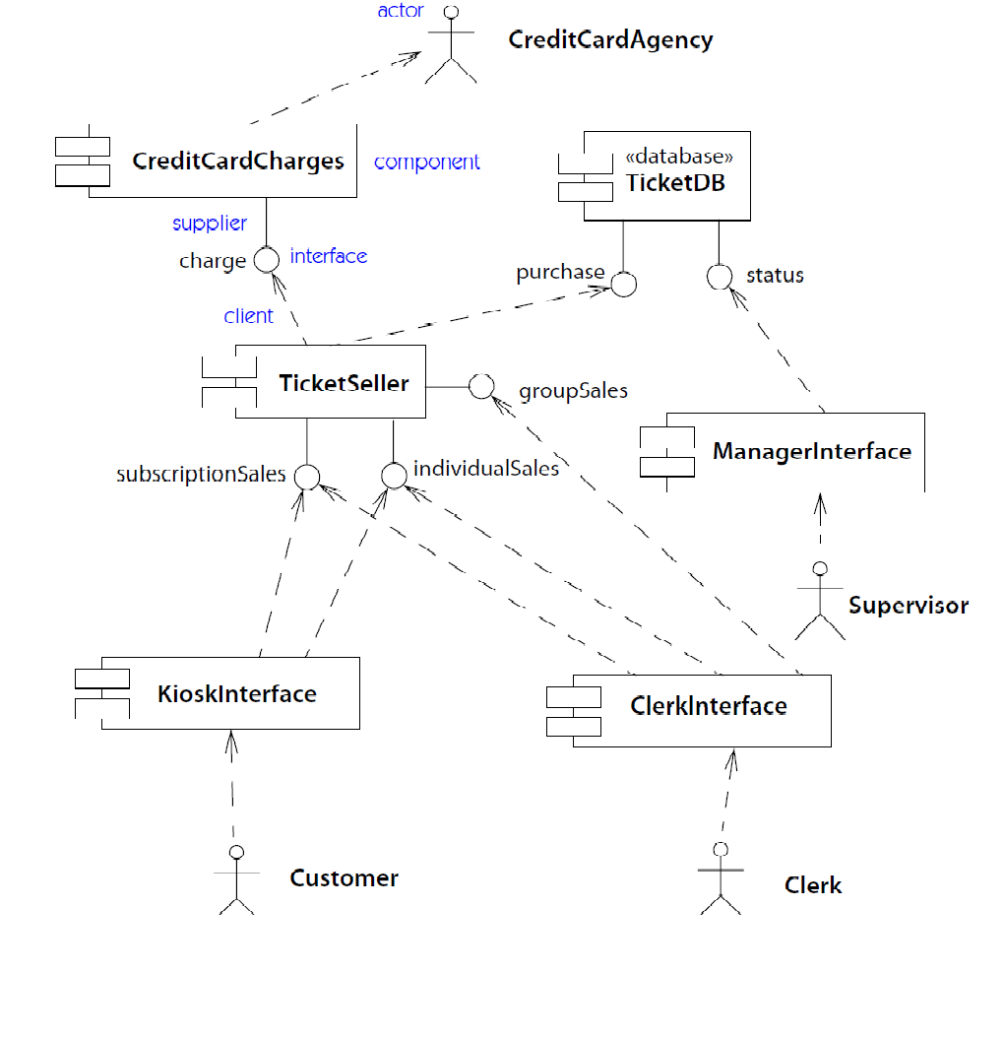
Introduction to UML
UML – Component Diagram

Slide 41
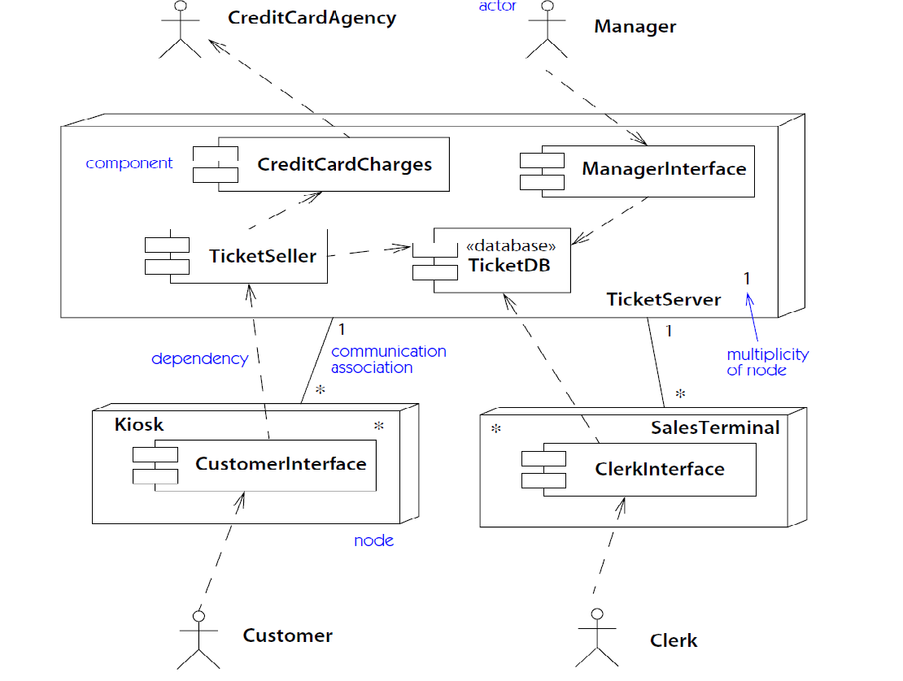
Introduction to UML
UML – Deployment Diagram

Slide 42
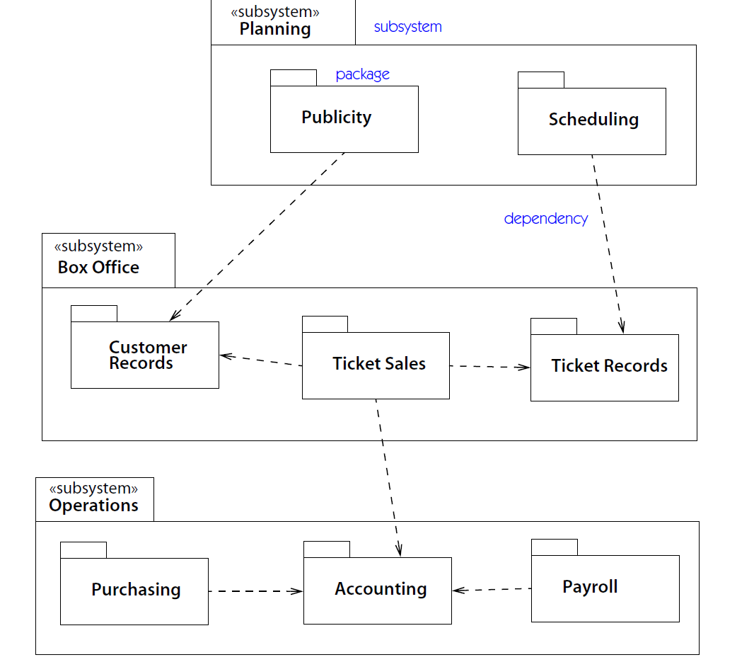
Introduction to UML
UML – System Architecture

Slide 43
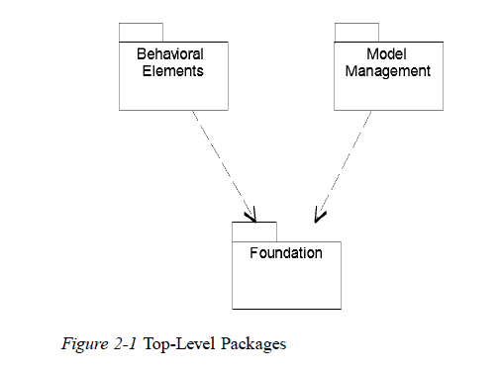
Introduction to UML
UML – definition
Language definition1.5.1
concrete syntax
abstract syntax (metamodel + constraints)
semantics

Slide 44
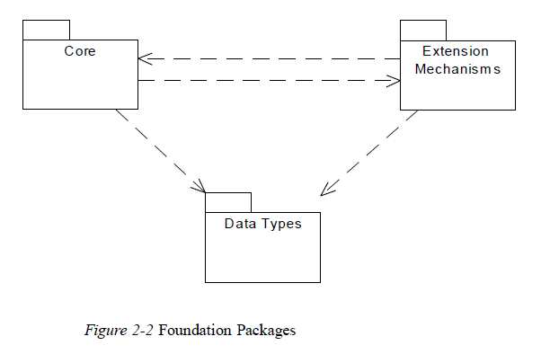
Introduction to UML
UML – definition; Foundation Packages

Slide 45
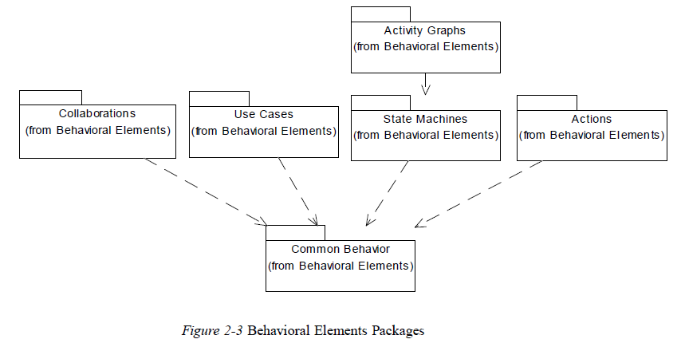
Introduction to UML
UML – definition; Behavioral Elements Packages

Slide 46
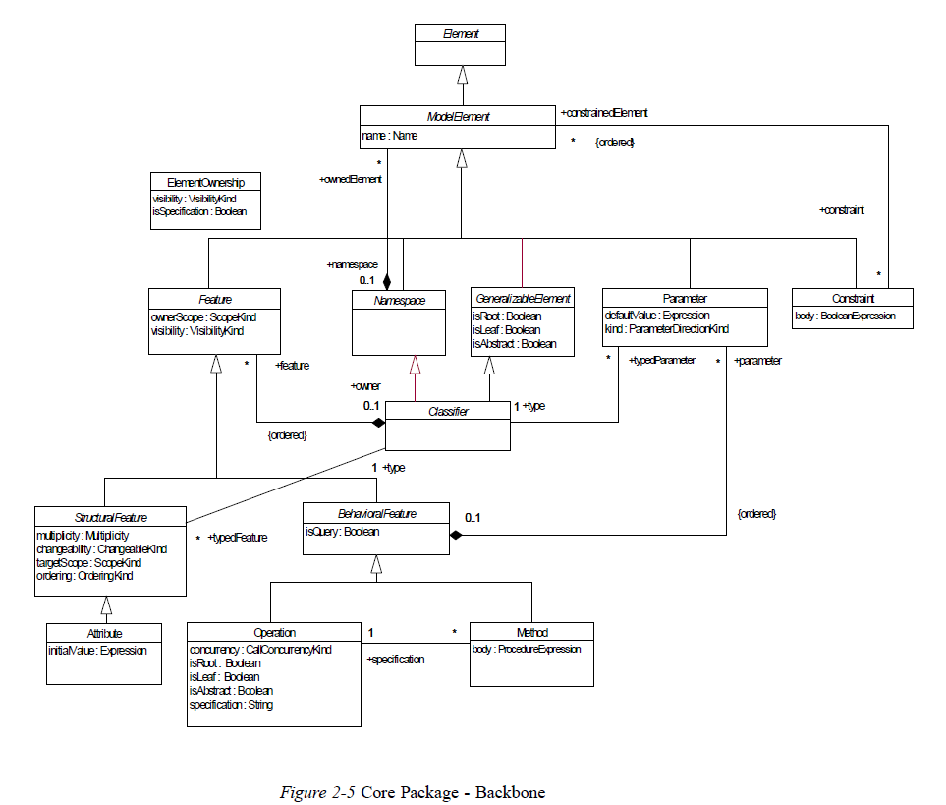
Introduction to UML

Slide 47
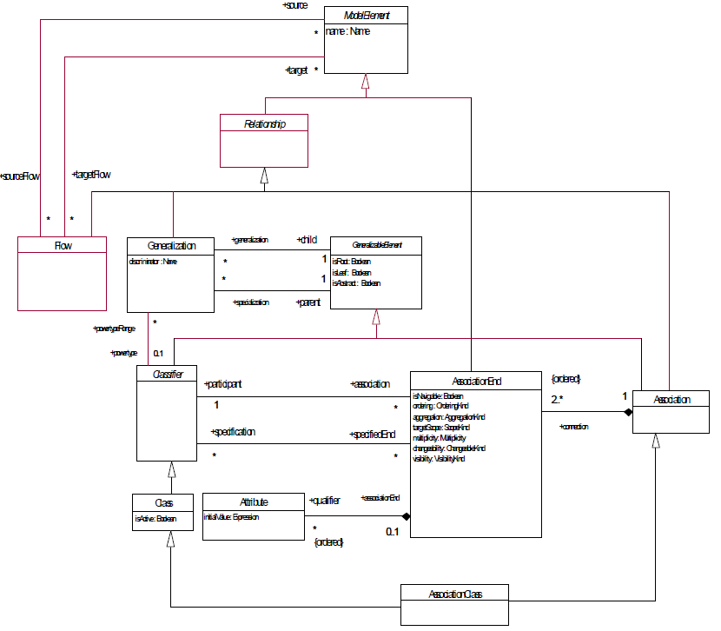
Introduction to UML

Slide 48
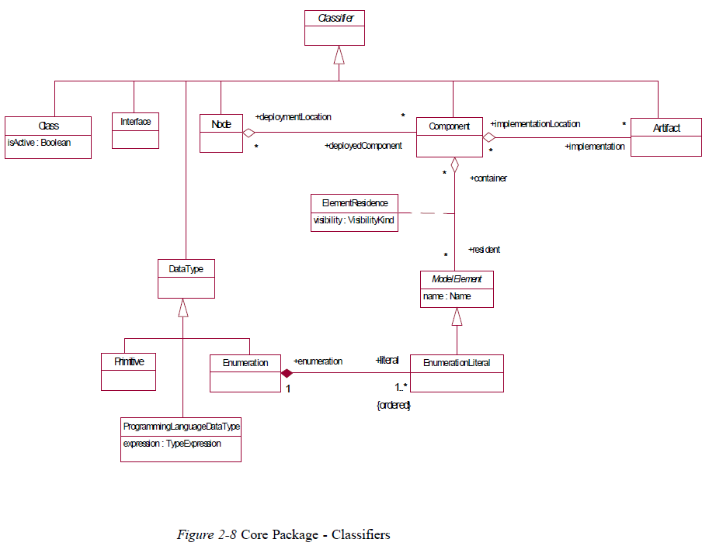
Introduction to UML

Slide 49
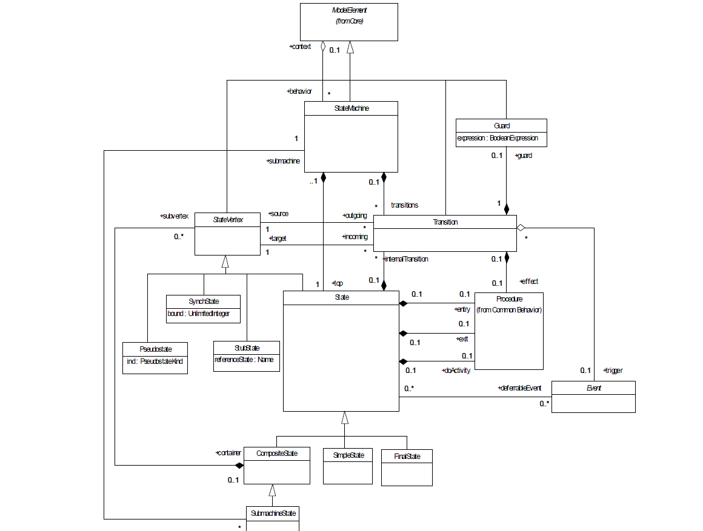
Introduction to UML

Slide 50

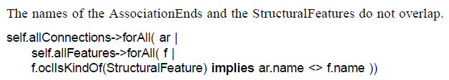
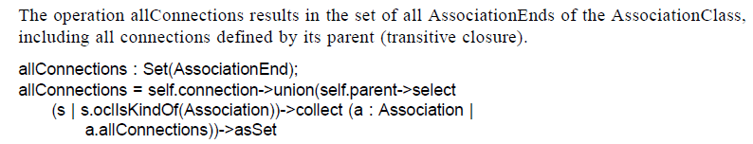
Introduction to UML

Slide 51
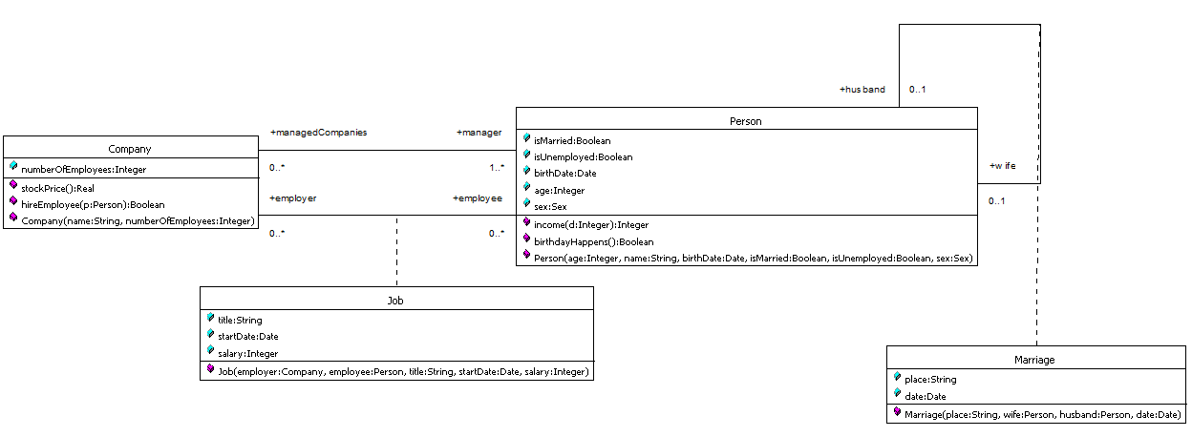
Introduction to UML

Slide 52
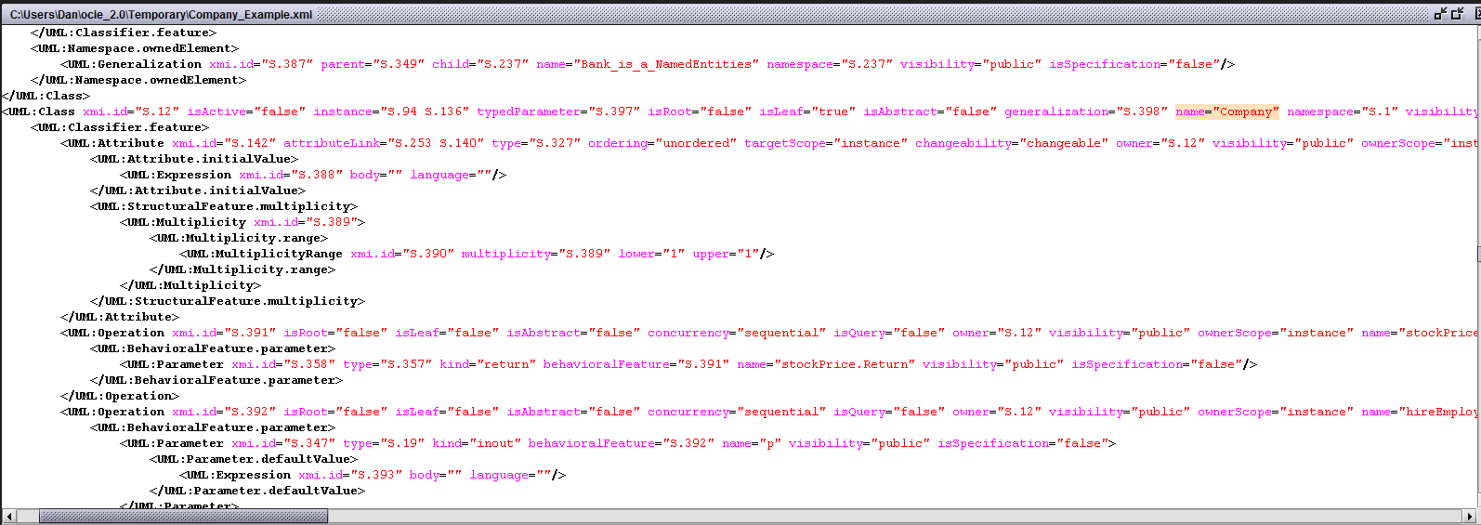
Introduction to UML

Slide 53
Introduction to UML
Thanks for your patience!

